Slide 1

Retention:
Feedback to Sites and
Participant Tracking Database

Slide 2
Retention Feedback To Sites
SCHARP will produce a Retention Report that lists per site and per visit
  # ppts expected for the visit (E)
  # of expected ppts who completed the visit (C)
  % ppts retained (% = E divided by C)
Terminating a ppt early due to missed visits/loss to follow-up does not help your retention data – that ppt is still expected
  In general, only terminate early if ppt withdraws consent

Slide 3
Retention Feedback To Sites
SCHARP will also provide each site (monthly) with a Missed Visit Report
  list of PTIDs who missed a visit last month along with the date of the last completed visit and window end for next expected visit
  Will allow for follow-up of individual PTIDs, and will hopefully help avoid chronic defaulters

Slide 4
Retention Help - Ppt Tracking Database
Purpose is to provide sites with a way to be immediately informed in cases when a ppt misses a scheduled visit
  Also provides how long is left in the visit window
Goal is get ppt in for the visit within the window so that the visit is “retained”
Provided to sites via a mini laptop
Suggest sites do not modify database

Slide 5
Participant Tracking Database
What it can do, if appropriate data is entered:
  Can let you know when Enrollment visits are coming up
  Can list per calendar month # of screens, # of enrollments
  Can generate a participant follow-up visit schedule with dates (like Excel tool)
  Can tell you which PTIDs have visits coming up on which day, and type of visit
  Can tell you which visits a PTID has missed
  Can tell you which PTIDs have terminated early
  Can inform which recruitment sources are most effective at yielding enrollments

Slide 6
Participant Tracking Database
What it cannot do:
  Indicate what procedures need to be done at a visit
  Tell you if a ppt is enrolled in MTN-015 or is currently pregnant
  Be used for co-enrollment identification
  Allow for separate dates for split visits to be entered ( therefore cannot trigger reminders for second half of split visits)
  Be used as source for any information
    All info should be documented in other places
Notes:
Other things that database cannot do:
-Synch up data with site outlook calendars. If sites want to scheduled visits on their outlook calendars, they will have to do this manually
-Cannot flag if a visit is scheduled outside of its’ window (will have to be checked manually when scheduling visits)
-Should not provide complete participant locator information.

Slide 7
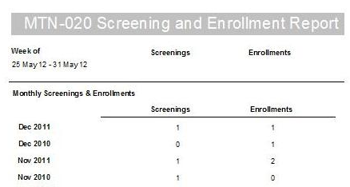
Report – Screened/Enrolled Per Month
Number of ppts screened, number enrolled per calendar month

Slide 8
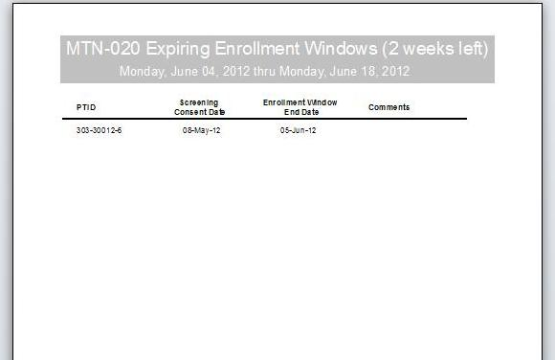
Report –
Time Left for Participants to Enroll
Clarifies when screening window will end for participants scheduled to enroll

Slide 9
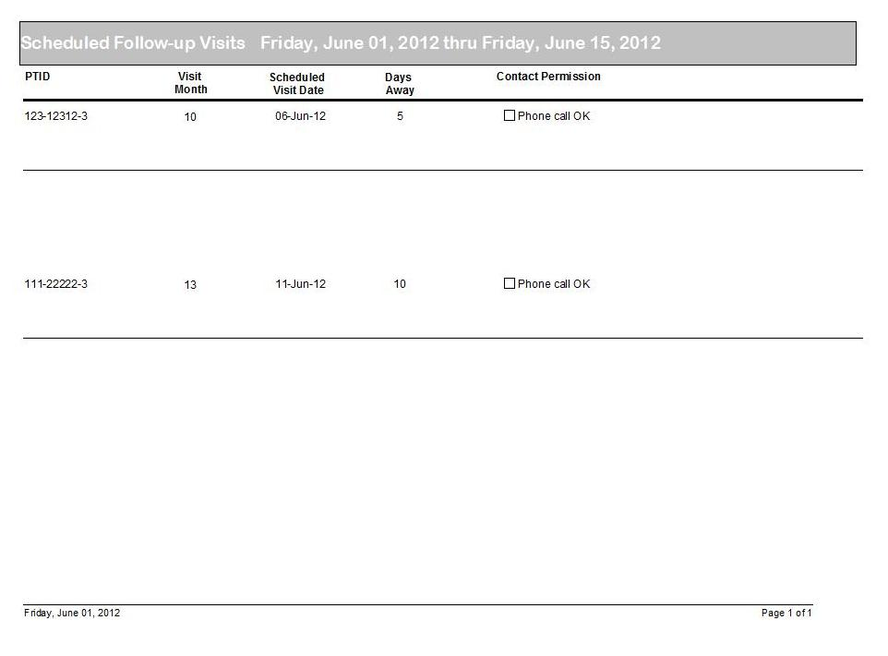
Report – Upcoming Scheduled Visits
3 reports:
-scheduled visits over the next 2 weeks
-schedule visits 3 weeks out
-scheduled visits by future date
Notes:
There are 3 reports that can be run for sites to see what upcoming scheduled visits will occur. The report displayed shows all visits that are scheduled over the next two weeks with the type of visit, scheduled visit date, how many days away the visit is, and whether you can contact the participant over the phone provided.
Another report can be generated to help plan for visits that are scheduled three weeks out. The last report shows scheduled visits by day after the site has selected a future date from the calendar.

Slide 10
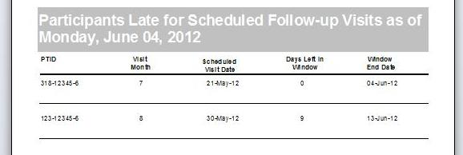
Report -
Participants Late for Follow-up Visits
Participants late (did not show up) for a scheduled follow-up visit, but still within the visit window

Slide 11
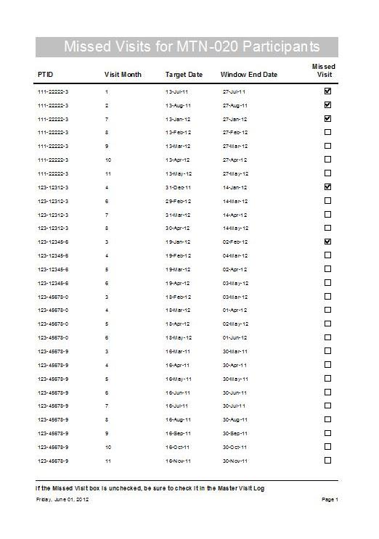
Report - Missed Visits
Cumulative Report of missed visits for all participants

Slide 12
Participant Tracking Database – Tips for Use
Identify 1-3 people at your site who will be primarily responsible for updating the information in the database
  Only accessible to 1 person at a time
Update the database daily – the reports are only as good as the data in the database
Prior to study start, closely review the reports. Determine who will create and distribute reports, and to whom, as well as the distribution schedule
  Some reports may ne needed daily, some weekly, some only monthly or quarterly

Slide 13
What are
your questions?

